Slide 1
File Operation in Python

Slide 2
What is a file?
Files are named locations on disk to store related information. They are used to permanently store data in a non-volatile memory (e.g. hard disk).
Since Random Access Memory (RAM) is volatile (which loses its data when the computer is turned off), we use files for future use of the data by permanently storing them.
When we want to read from or write to a file, we need to open it first. When we are done, it needs to be closed so that the resources that are tied with the file are freed.

Slide 3
In Python, a file operation takes place in the following order:
Open a file
Read or write (perform operation)
Close the file

Slide 4
Opening Files in Python
Python has a built-in open() function to open a file. This function returns a file object, also called a handle, as it is used to read or modify the file accordingly.
>>> f = open("test.txt") # open file in current directory
>>> f = open("C:/Python38/README.txt") # specifying full path

Slide 5
We can specify the mode while opening a file. In mode, we specify whether we want to read r, write w or append a to the file. We can also specify if we want to open the file in text mode or binary mode.
The default is reading in text mode. In this mode, we get strings when reading from the file.
binary mode returns bytes and this is the mode to be used when dealing with non-text files like images or executable files.

Slide 6
Mode | Description
r | Opens a file for reading. (default)
w | Opens a file for writing. Creates a new file if it does not exist or truncates the file if it exists.
x | Opens a file for exclusive creation. If the file already exists, the operation fails.
a | Opens a file for appending at the end of the file without truncating it. Creates a new file if it does not exist.
t | Opens in text mode. (default)
b | Opens in binary mode.
+ | Opens a file for updating (reading and writing)

Slide 7
f = open("test.txt") # equivalent to 'r' or 'rt'
f = open("test.txt",'w') # write in text mode
f = open("img.bmp",'r+b') # read and write in binary mode

Slide 8
In other languages, the character a does not imply the number 97 until it is encoded using ASCII (or other equivalent encodings).
Moreover, the default encoding is platform dependent. In windows, it is cp1252 but utf-8 in Linux.
So, we must not also rely on the default encoding or else our code will behave differently in different platforms.
Hence, when working with files in text mode, it is highly recommended to specify the encoding type.
f = open("test.txt", mode='r', encoding='utf-8')

Slide 9
Closing Files in Python
When we are done with performing operations on the file, we need to properly close the file.
Closing a file will free up the resources that were tied with the file. It is done using the close() method available in Python.
Python has a garbage collector to clean up unreferenced objects but we must not rely on it to close the file.

Slide 10
f = open("test.txt", encoding = 'utf-8')
# perform file operations
f.close()

Slide 11
This method is not entirely safe. If an exception occurs when we are performing some operation with the file, the code exits without closing the file.
A safer way is to use a try...finally block.
try:
f = open("test.txt", encoding = 'utf-8')
# perform file operations
finally:
f.close()

Slide 12
This way, we are guaranteeing that the file is properly closed even if an exception is raiseThe best way to close a file is by using the with statement.
This ensures that the file is closed when the block inside the with statement is exited.
We don't need to explicitly call the close() method. It is done internally.
with open("test.txt", encoding = 'utf-8') as f:
# perform file operationsd that causes program flow to stop.

Slide 13
Writing to Files in Python
In order to write into a file in Python, we need to open it in write w, append a or exclusive creation x mode.
We need to be careful with the w mode, as it will overwrite into the file if it already exists. Due to this, all the previous data are erased.
Writing a string or sequence of bytes (for binary files) is done using the write() method. This method returns the number of characters written to the file.
with open("test.txt",'w',encoding = 'utf-8') as f:
f.write("my first file\n")
f.write("This file\n\n")
f.write("contains three lines\n")

Slide 14
This program will create a new file named test.txt in the current directory if it does not exist. If it does exist, it is overwritten.

Slide 15
Reading Files in Python
To read a file in Python, we must open the file in reading r mode.
There are various methods available for this purpose. We can use the read(size) method to read in the size number of data. If the size parameter is not specified, it reads and returns up to the end of the file.
We can read the text.txt file we wrote in the above section in the following way:
>>> f = open("test.txt",'r',encoding = 'utf-8')
>>> f.read(4) # read the first 4 data
'This'
>>> f.read(4) # read the next 4 data
' is '
>>> f.read() # read in the rest till end of file
'my first file\nThis file\ncontains three lines\n'
>>> f.read() # further reading returns empty sting
''

Slide 16
We can see that the read() method returns a newline as '\n'. Once the end of the file is reached, we get an empty string on further reading.
We can change our current file cursor (position) using the seek() method. Similarly, the tell() method returns our current position (in number of bytes).
>>> f.tell() # get the current file position
56
>>> f.seek(0) # bring file cursor to initial position
0
>>> print(f.read()) # read the entire file
This is my first file
This file
contains three lines

Slide 17
We can read a file line-by-line using a for loop. This is both efficient and fast.
>>> for line in f:
... print(line, end = '')
...
This is my first file
This file
contains three lines

Slide 18
In this program, the lines in the file itself include a newline character \n. So, we use the end parameter of the print() function to avoid two newlines when printing.
Alternatively, we can use the readline() method to read individual lines of a file. This method reads a file till the newline, including the newline character.
>>> f.readline()
'This is my first file\n'
>>> f.readline()
'This file\n'
>>> f.readline()
'contains three lines\n'
>>> f.readline()
''

Slide 19
the readlines() method returns a list of remaining lines of the entire file. All these reading methods return empty values when the end of file (EOF) is reached.
>>> f.readlines()
['This is my first file\n', 'This file\n', 'contains three lines\n']

Slide 20
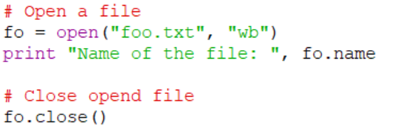
Python file method:
These 1.close():
Closes the file.are the certain file method:

Slide 21
2.detach():
detach() method is used to separate the underlying raw stream from the buffer and return it. After the raw stream has been detached, the buffer is in an unusable state.
file.detach()

Slide 22

fileno():
The fileno() method returns the file descriptor of the stream, as a number.
An error will occur if the operator system does not use a file descriptor.

Slide 23

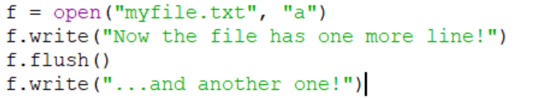
4.flush():
Flushes the internal buffer.

Slide 24

read()
Returns the file content.

Slide 25

readline():
The readline() method returns one line from the file.

Slide 26
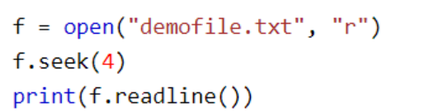
seek():
Change the file position.

Slide 27
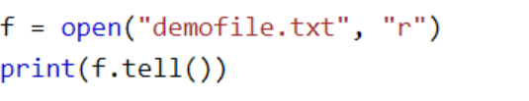
tell():
The tell() method returns the current file position in a file stream.

Slide 28
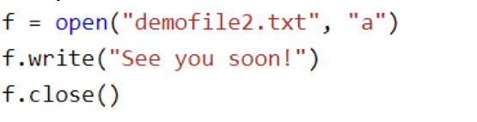
write()
Writes the specified string to the file.

Slide 29
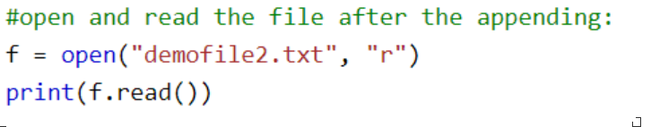

Slide 30
OS Module:
The OS module provides functions for interacting with the operating system. OS comes under Python’s standard utility modules. This module provides a portable way of using operating system dependent functionality. The os and os.path modules include many functions to interact with the file system. All functions in os module raise OSError in the case of invalid or inaccessible file names and paths, or other arguments that have the correct type but are not accepted by the operating system.
There are different methods available in the OS module for creating a director. These are –
os.mkdir()
os.makedirs()

Slide 31
Using os.mkdir():
os.mkdir() method is used to create a directory named path with the specified numeric mode. This method raises FileExistsError if the directory to be created already exists.

Slide 32
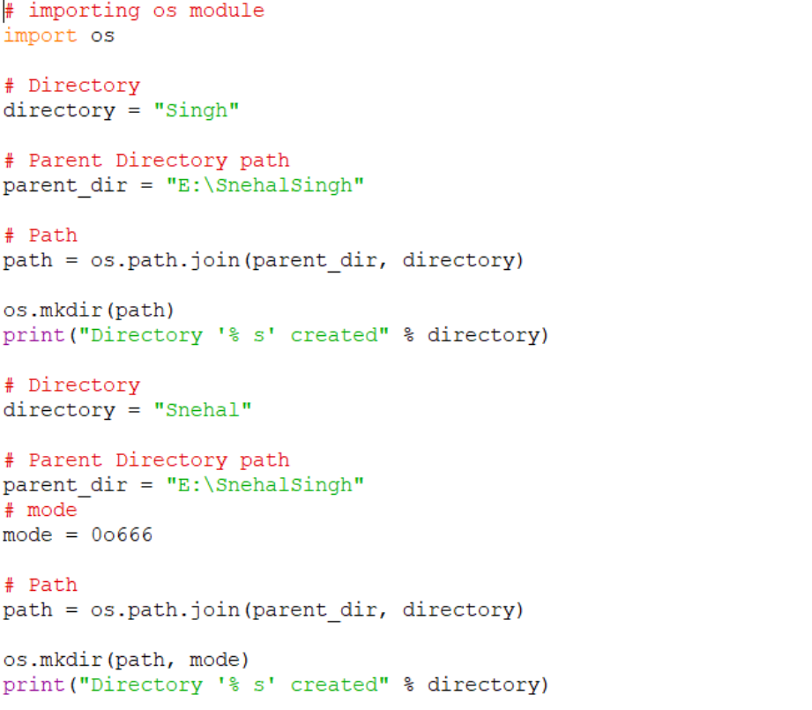

Slide 33


Slide 34
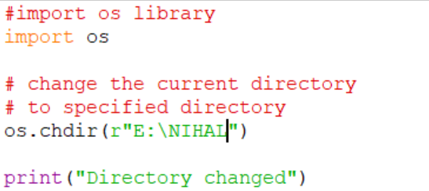
Changing Directory:
os.chdir() method used to change the current working directory to a specified path. It takes only a single argument as a new directory path.

Slide 35
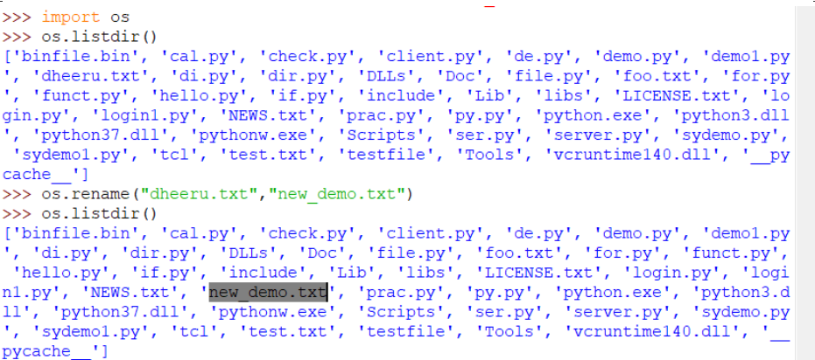
Renaming a Directory or a File
The rename() method is used to rename a directory or a file. The first argument is the old name and the new name must be supplied as the second argument.

Slide 36
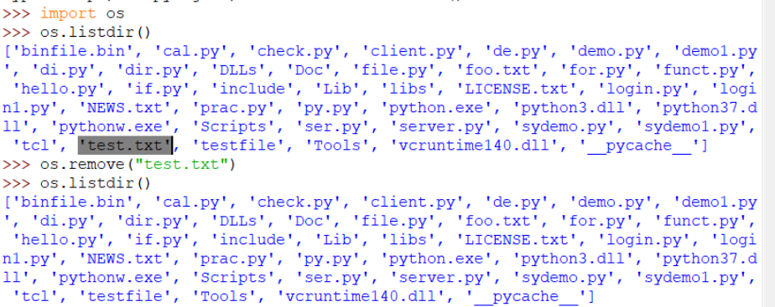
Deleting or removing directory:
os.remove() method in Python is used to remove or delete a file path. This method can not remove or delete a directory. If the specified path is a directory then OSError will be raised by the method.

Slide 37
Command line:
Command line arguments are those values that are passed during calling of program along with the calling statement. Thus, the first element of the array sys.argv() is the name of the program itself. sys.argv() is an array for command line arguments in Python. To employ this module named “sys” is used. sys.argv is similar to an array and the values are also retrieved like a Python array.

Slide 38
The sys module:
The sys module provides functions and variables used to manipulate different parts of the Python runtime environment. This module provides access to some variables used or maintained by the interpreter and to functions that interact strongly with the interpreter.

Slide 39
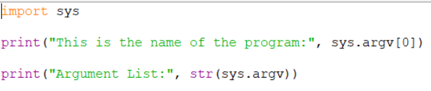

Slide 40
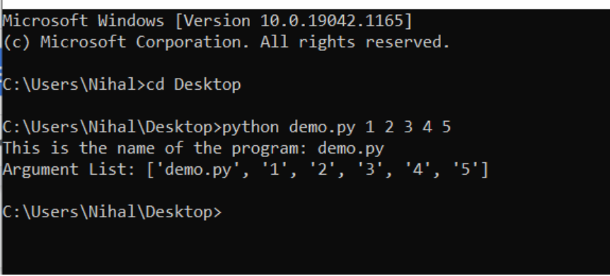

Slide 41
Functions that can be used with sys.argv
len()- function is used to count the number of arguments passed to the command line. Since the iteration starts with 0, it also counts the name of the program as one argument. If one just wants to deal with other inputs they can use (len(sys.argv)-1).
str()- this function is used to present the array as a string array. Makes displaying the command line array easier and better.

Slide 42
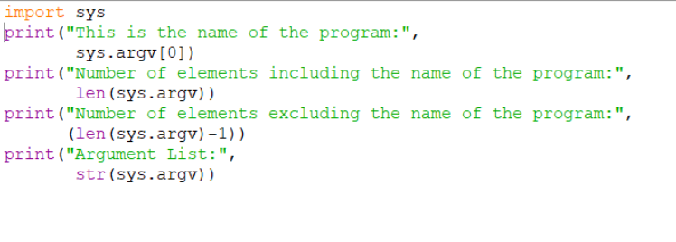

Slide 43
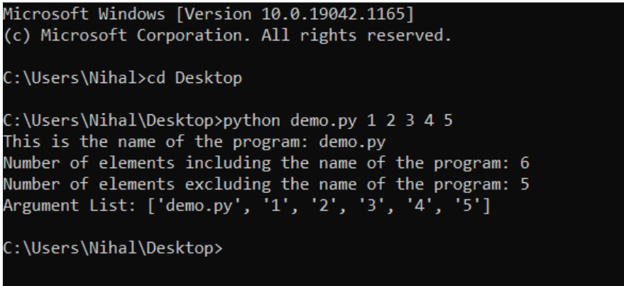

Slide 44
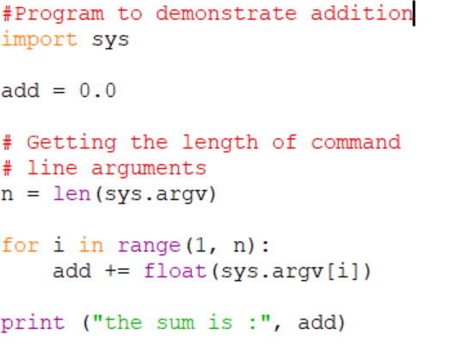

Slide 45
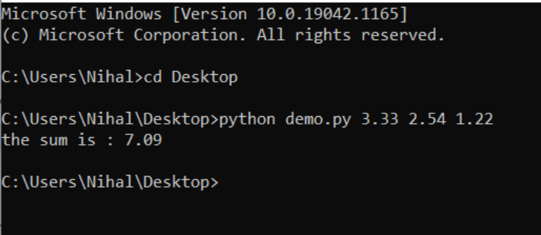

Slide 46
Serialization
It is a process of converting a python object into a byte stream that is stored in the file. This process is also called Pickling.
Deserialization
This is the reverse of Serialization.
It is a process of converting a byte of steam back to a python object.
In order to achieve serialization and deserialization we need to import pickle module.
Following are the methods from the pickle module used to achieve serialization and deserialization.

Slide 47
dump(object,file_pointer)
This method is used to save the object to the file in a byte stream.
load(file_pointer)
This method is used to retrieve the object stored in the file.

Slide 48
The common methods for serializing and deserializing methods are JSON, Pickle, Joblib, onnx or pmml, keras supports hdf5 and alternative serialization packages dill which generalizes pickle at the cost of performance.
Lets see few practical examples of JSON, Pickle, joblib, Yaml

Slide 49
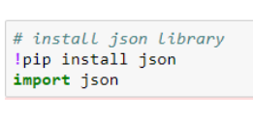
JSON Serialization and Deserialization
Any Python object can be serialized into JSON format and vice versa.
Without involving any objects as well, JSON strings can be formed and interchanged between any two processes, client and server as data.
Several REST APIs and web services return data as JSON. Even the error messages from the REST APIs are returned as JSON strings.
JSON is a text based data interchange format
Though the name has “JavaScript” on it, JSON is a language independent data interchange format. its abbreviation of JavaScript Object Notation.

Slide 50
Javascript Object Notation
JSON exposes an API familiar to users of the standard library marshal and pickle modules.

Slide 51
Encoding basic Python object hierarchies:
>>>
>>> import json
>>> json.dumps(['foo', {'bar': ('baz', None, 1.0, 2)}])
'["foo", {"bar": ["baz", null, 1.0, 2]}]'
>>> print(json.dumps("\"foo\bar"))
"\"foo\bar"
>>> print(json.dumps('\u1234'))
"\u1234"
>>> print(json.dumps('\\'))
"\\"
>>> print(json.dumps({"c": 0, "b": 0, "a": 0}, sort_keys=True))
{"a": 0, "b": 0, "c": 0}
>>> from io import StringIO
>>> io = StringIO()
>>> json.dump(['streaming API'], io)
>>> io.getvalue()
'["streaming API"]'

Slide 52
Compact encoding:
>>> import json
>>> json.dumps([1, 2, 3, {'4': 5, '6': 7}], separators=(',', ':'))
'[1,2,3,{"4":5,"6":7}]'

Slide 53
Pretty printing:
>>>
>>> import json
>>> print(json.dumps({'4': 5, '6': 7}, sort_keys=True, indent=4))
{
"4": 5,
"6": 7
}

Slide 54
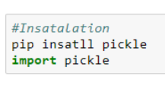
Pickle Serialization and Deserialization
Pickling is the process whereby a Python object hierarchy is converted into a byte stream (usually not human readable) to be written to a file, this is also known as Serialization. Unpickling is the reverse operation, whereby a byte stream is converted back into a working Python object hierarchy.

Slide 55
Pickle is operationally simplest way to store the object. The Python Pickle module is an object-oriented way to store objects directly in a special storage format

Slide 56
Python pickle module is used for serializing and de-serializing a Python object structure. Any object in Python can be pickled so that it can be saved on disk. What pickle does is that it “serializes” the object first before writing it to file. Pickling is a way to convert a python object (list, dict, etc.) into a character stream. The idea is that this character stream contains all the information necessary to reconstruct the object in another python script.

Slide 57
The pickle module is used for implementing binary protocols for serializing and de-serializing a Python object structure.
Pickling: It is a process where a Python object hierarchy is converted into a byte stream.
Un pickling: It is the inverse of Pickling process where a byte stream is converted into an object hierarchy.

Slide 58
Methods provided by the pickle module :
The pickle interface provides four different methods.
dump() − The dump() method serializes to an open file (file-like object).
dumps() − Serializes to a string
load() − Deserializes from an open-like object.
loads() − Deserializes from a string.

Slide 59
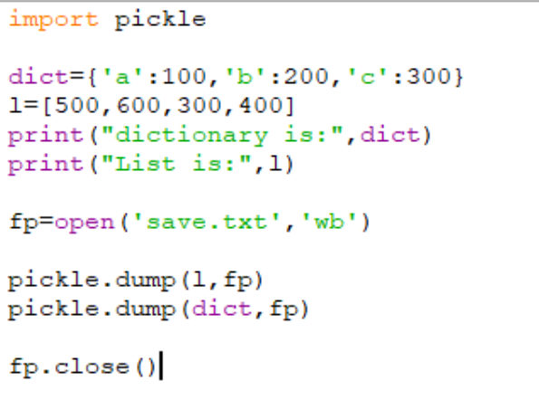

Slide 60
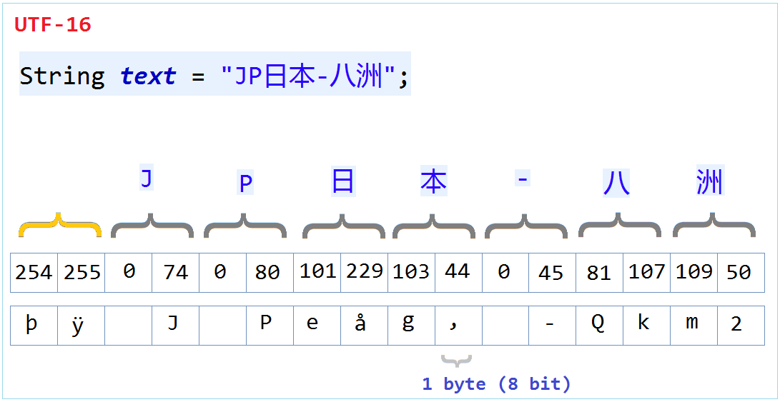

Slide 61
After running the above program save.txt file is created in the same directory as that of demo.py file and it stored the object in binary format.

Slide 62
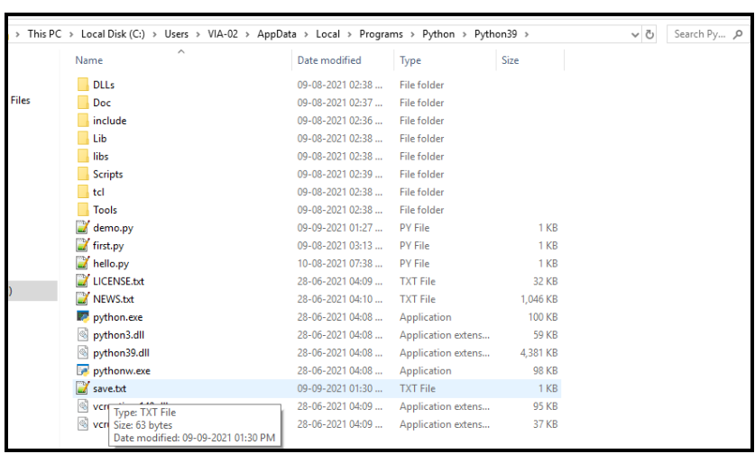

Slide 63
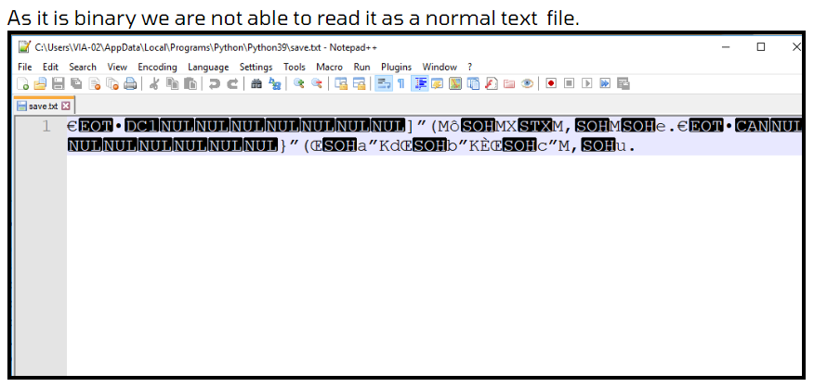

Slide 64
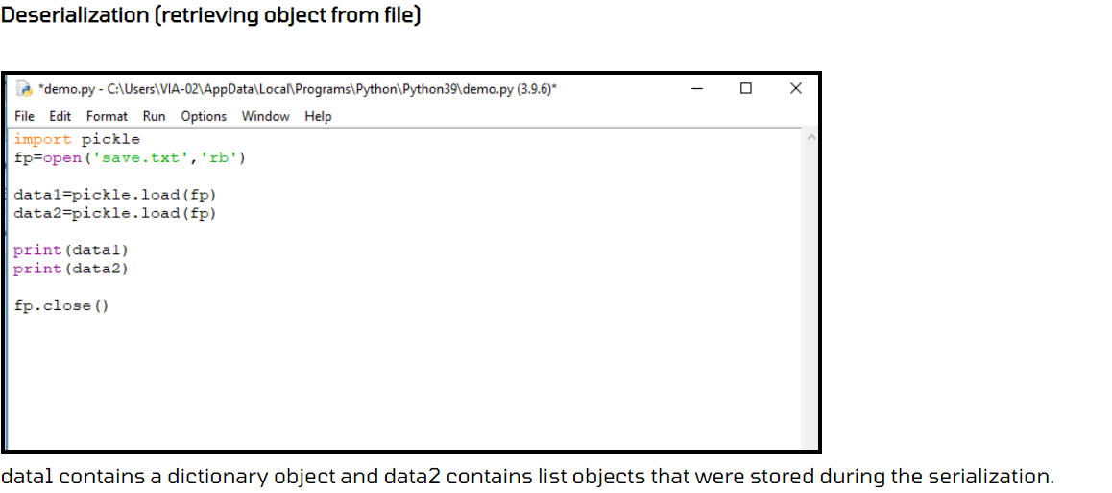

Slide 65
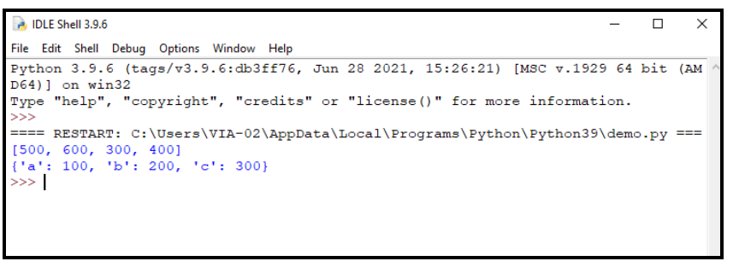

Slide 66
YAML Serialization and Deserialization
YAML is my favorite format. It is a human-friendly data serialization format. Unlike Pickle and JSON, it is not part of the Python standard library, so you need to install it

Slide 67


